Slide 1




Project Title: SeismoSense: AI & IoT-Powered Earthquake Prediction System
Team ID: Team_9236
Team Leader: Kaushal Prasad
Team Member 1: Abhishek Singh
Team Member 2: Vicky Kumar
Team Member 3: SA Parthiv
Team Member 4: Gauransh Gautam

Slide 2

Table of Content
Problem Statement
Project Overview – Introduction
End Users
Wow Factor in Project
Modelling/Block Diagram/Flow of Project
Result/outcomes
Conclusion
Future Perspective

Slide 3
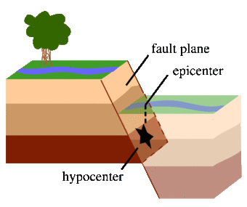
Project Objectives
To develop an AI & IoT-based earthquake early warning system.
Detect P-waves (Primary Waves) using seismic sensors before strong shaking occurs.
Use AI models to predict earthquake magnitude and location.
Send real-time alerts via mobile notifications, sirens, and automated systems.
Minimize loss of life and property by providing crucial seconds/minutes of warning.

Slide 4
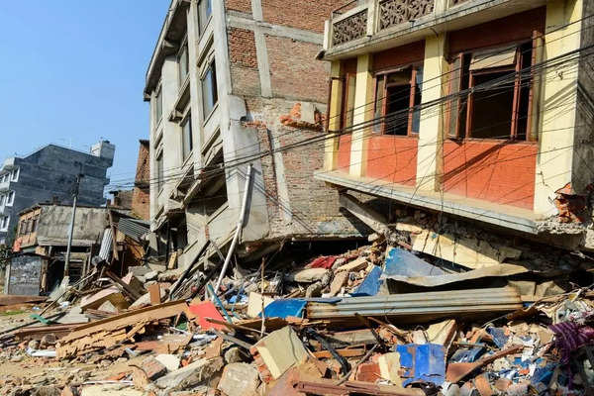
Problem Statement
Earthquakes are unpredictable and cause massive destruction.
Traditional warning systems are slow or inaccurate.
Current methods do not effectively use AI & IoT to detect early seismic activity.
Lack of automated response systems to trigger safety measures.
Need for an intelligent, real-time system to provide early warnings.

Slide 5
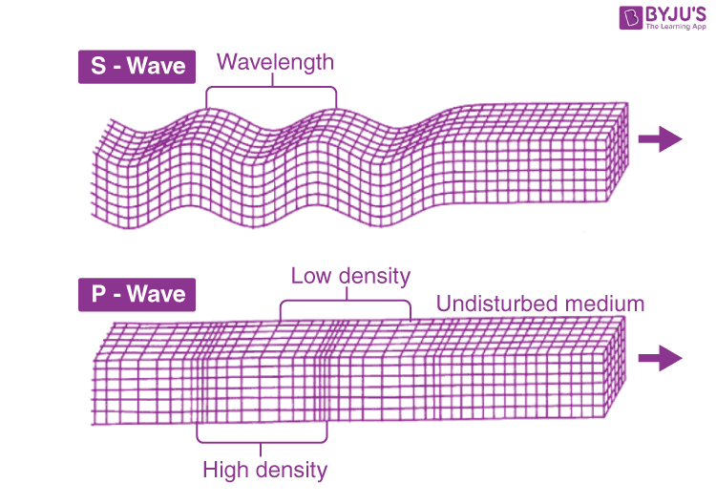
Project overview - Introduction
This project combines IoT, AI, and seismic sensors to predict earthquakes.
Uses P-wave detection (fast but less harmful waves) to predict S-waves (damaging waves).
Cloud-based AI model processes real-time seismic data for predictions.
Automated alert system sends notifications and activates safety protocols.

Slide 6
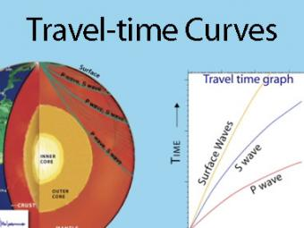
End User
Government agencies & disaster management teams (for early evacuation).
Residents in earthquake-prone areas (real-time safety alerts).
Hospitals & emergency services (to prepare for rescue operations).
Industries & power plants (to prevent damage and shut down hazardous processes).
Railway & metro systems (automatic braking before seismic impact).

Slide 7
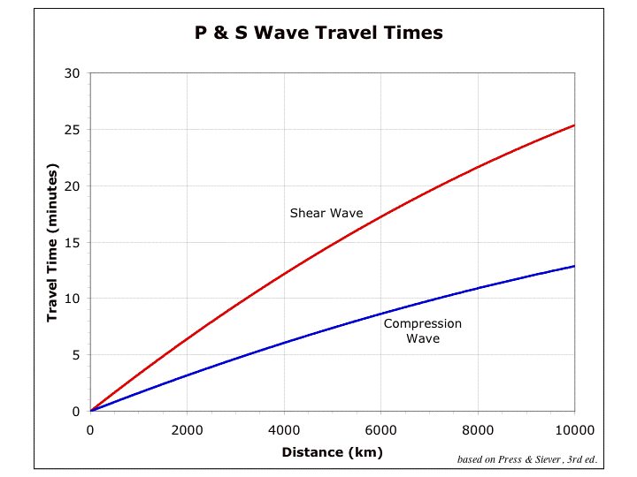
Wow Factor in Solution
Faster than traditional warning systems (AI detects patterns in real-time).
Affordable IoT-based sensors can be deployed in homes, industries, and cities.
Automated safety actions like shutting down elevators, gas pipelines, and power grids.
Scalable system that can be integrated with global earthquake databases.

Slide 8
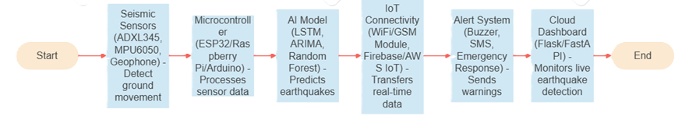
Modelling
System Architecture:-

Slide 9
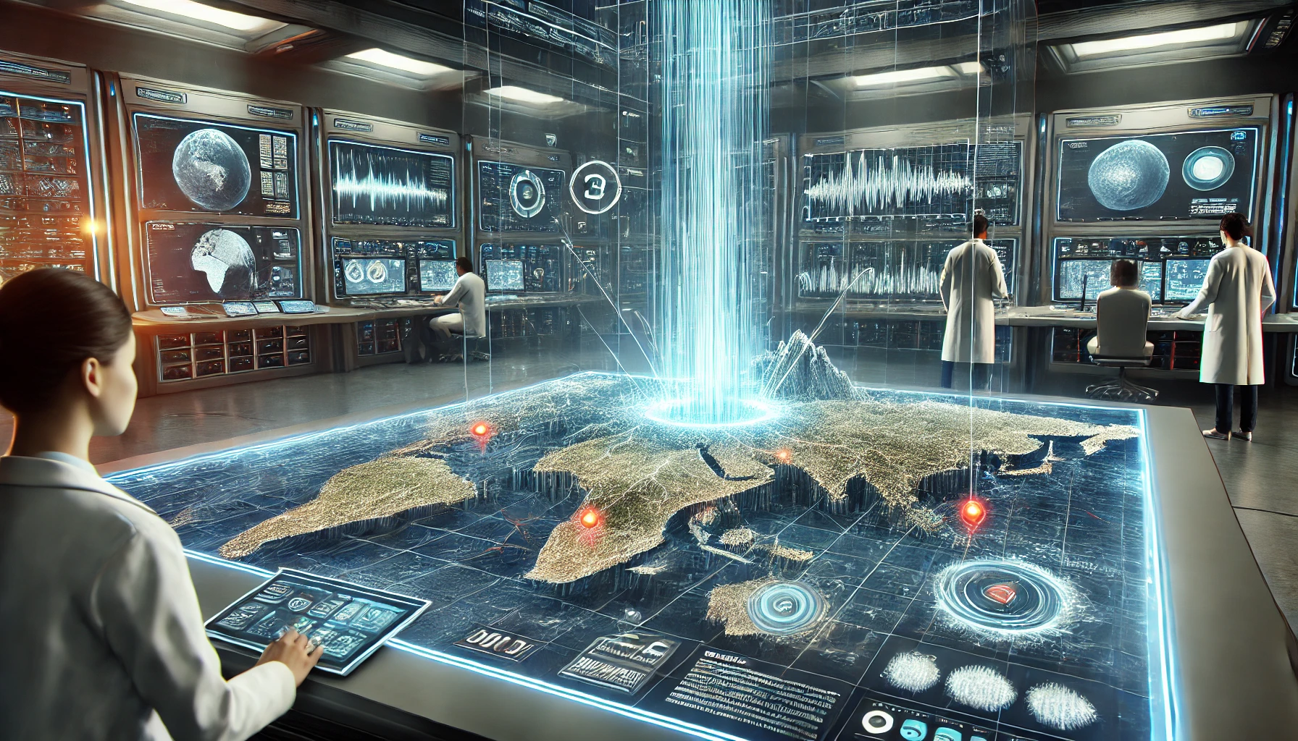
Result / Outcomes
Prototype developed for real-time earthquake detection using AI & IoT.
Successfully detects P-waves and sends alerts before major tremors.
Real-time alerts via SMS, sirens, and automated shutdown mechanisms.
System tested on a small scale with promising results.

Slide 10
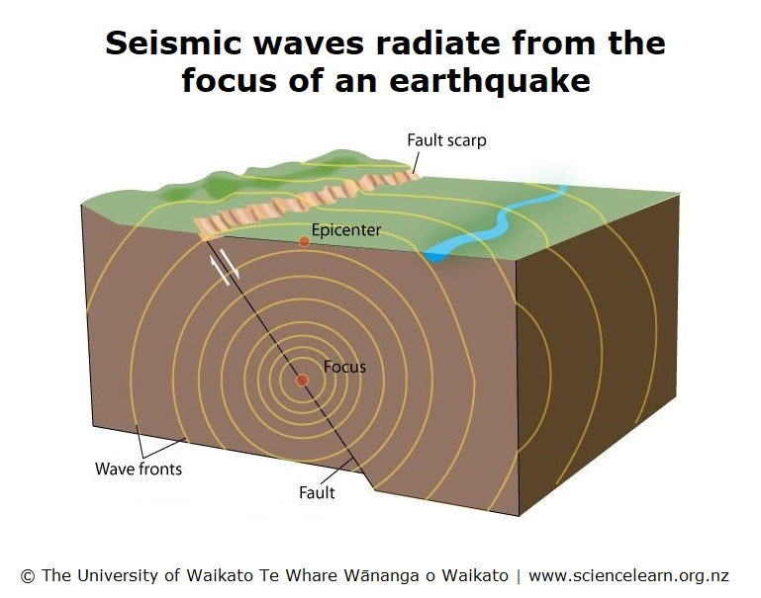
Conclusion
SeismoSense leverages AI & IoT to predict earthquakes in real-time.
Provides early warnings, helping save lives & minimize property damage.
Future improvements include better AI models, wider IoT sensor coverage, and industry collaborations.

Slide 11
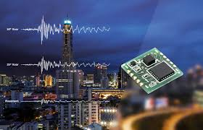
Future Perspective
Enhance AI model accuracy with deep learning techniques.
Deploy IoT sensors in multiple high-risk locations.
Integrate GIS data for better earthquake prediction.
Collaborate with government & disaster management agencies for real-world implementation.

Slide 12
Thank you...!
Thank you for your time! Any Questions?
Notes:
12

